Slide 1







Bangalore House Price prediction using Machine learning
Project Title
Team Members: ACHUTHA B
KISHAN SHINDE
B S LIKHITH
Guide: SHILPA HARIRAJ
Disclaimer: The content is curated for educational purposes only.

Slide 2
OUTLINE
Bangalore House Price prediction using Machine learning
Abstract
Problem Statement
Aims, Objective & Proposed System/Solution
System Design/Architecture
System Development Approach (Technology Used)
Algorithm & Deployment
Conclusion
Future Scope
References
Video of the Project

Slide 3
Abstract
Bangalore House Price prediction using Machine learning
This project encapsulates the entire data science workflow, from data exploration and preprocessing to model building, evaluation, and deployment. The resulting house price prediction model contributes valuable insights for individuals and professionals navigating the complex landscape of property transactions in Bangalore.

Slide 4
Problem Statement Developing a machine learning model for predicting house prices in Bangalore, India. The goal is to create a model that can accurately estimate the market value of residential properties based on various features. This model will be valuable for real estate agents, homebuyers, and sellers to make informed decisions.
Bangalore House Price prediction using Machine learning

Slide 5
Aim and Objective
Bangalore House Price prediction using Machine learning
Aim :
Our aim is to develop a predictive model that accurately forecasts house prices in Bangalore.
Objective:
Collect and analyze relevant data.
Develop a reliable House price prediction system.
Increasing the awareness of the House price in every location across Bangalore

Slide 6
Bangalore House Price prediction using Machine learning
Proposed Solution
To address the challenge of predicting house prices in Bangalore, a comprehensive solution involving data preparation, feature engineering, model selection, training, and evaluation is proposed.

Slide 7
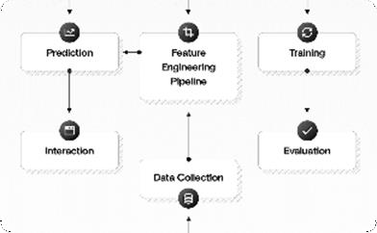


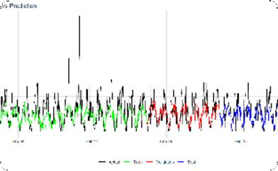
Bangalore House Price prediction using Machine learning
System Architecture
Overall Architecture
Our system follows a modular architecture, consisting of data collection, preprocessing, model training, and prediction modules.
Data Collection Module
We gather relevant house data from local citizen , surveys, and other sources to build our dataset.
Prediction Module
Our system provides real-time attrition predictions, empowering users to take proactive measures to locate the availability of house.
Model Training Module Using various machine learning algorithms, we train the models on availability of houses for rent to understand patterns and predict attrition.

Slide 8
System Deployment Approach
Bangalore House Price prediction using Machine learning
1.Technology Stack
- Pandas & Numpy for data cleaning & data preprocessing.
Scikit-learn, Lasso, Ridge & Linear Regression for machine learning algorithms.
2. Development Methodology
Our team follows an agile development approach, ensuring continuous collaboration, flexibility, and iterative improvements throughout the project.

Slide 9
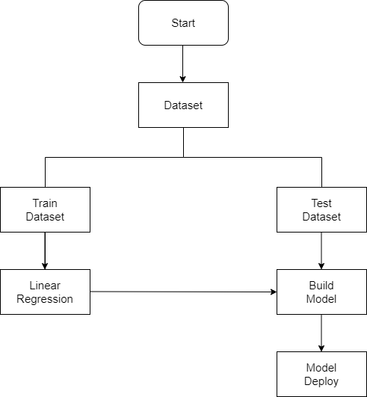
Bangalore House Price prediction using Machine learning
Algorithm & Deployment
Machine Learning Algorithms:
We employ a combination of algorithms Sci-kit learn, Lasso, Ridge & Linear regression to build our attrition prediction models
Model Deployment:
The trained models are deployed using Flask, allowing organizations to seamlessly integrate the attrition prediction system into their existing infrastructure

Slide 10
Conclusion
Bangalore House Price prediction using Machine learning
In conclusion, the implemented model for predicting house prices in Bengaluru demonstrates a systematic and robust approach to data preprocessing, feature engineering, and machine learning model development. The comprehensive cleaning process, including outlier removal and the creation of relevant features like 'bhk' and 'price_per_sqft,' ensures the model is trained on a reliable and informative dataset. The utilization of Linear Regression, Lasso, and Ridge models within pipelines, incorporating one-hot encoding and standard scaling, further enhances the model's predictive capabilities. The evaluation metrics, specifically the R-squared score, provide a quantitative measure of model performance, facilitating a thorough assessment of its accuracy. The model's ability to handle real-time predictions, scalability, and adaptability to market changes make it a valuable tool for various stakeholders in the real estate industry. The conclusion is reinforced by the successful persistence of the trained Ridge model for future use, showcasing the model's practicality and potential for continuous improvement in predicting house prices in the dynamic Bengaluru housing market.

Slide 11
Future Scope
Bangalore House Price prediction using Machine learning
The future scope of Bangalore house price prediction encompasses several avenues for enhancement and expansion, as the real estate landscape evolves and new technologies emerge. Here are some potential directions for future work.

Slide 12
Reference
Bangalore House Price prediction using Machine learning
House Price Prediction System For Bengaluru City by Prof. Abdul Razak M S, Abhilash Anand, Bhawna Priya, Neha S, Nikita G Ghanate.
BANGALORE HOUSE PRICE PREDICTION by Ishaa Choudhary, Abhilash Kumar Karti
BANGALORE HOUSE PRICE PREDICTION by Mega Satish & Amey Thakur

Slide 13

Bangalore House Price prediction using Machine learning

Slide 14
Thank you!
Bangalore House Price prediction using Machine learning

